Slide 1
Programming fundamentals
Week 01 – Introduction to Fundamentals of programming
Course Instructor : Engr.Asma Khan

Slide 2
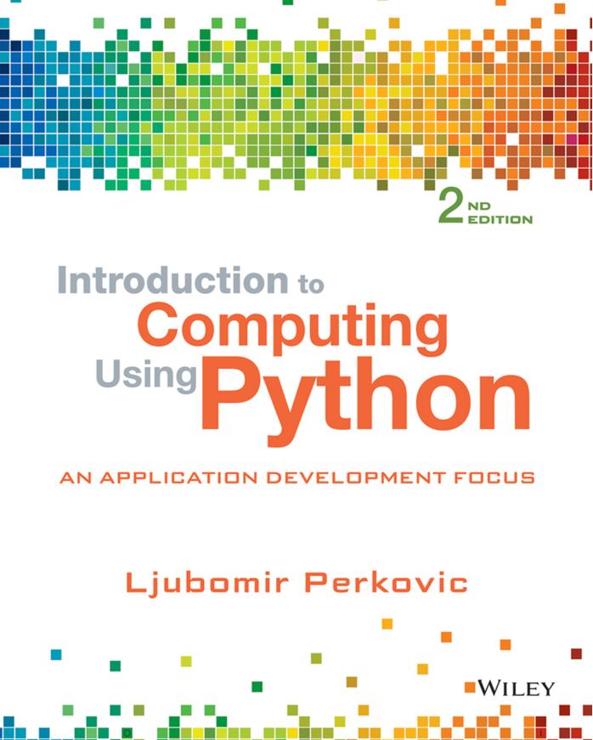
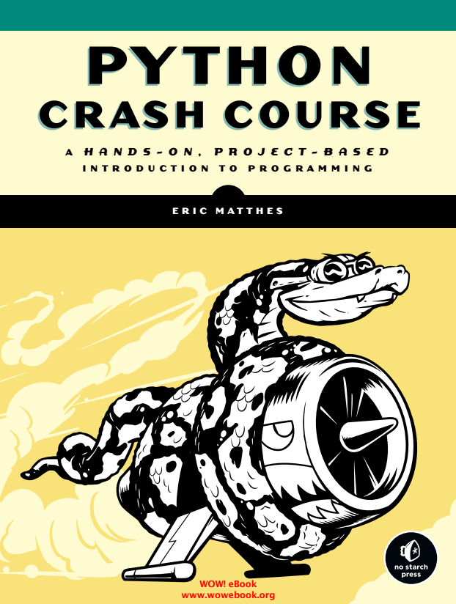
Course books & Materials

Slide 3
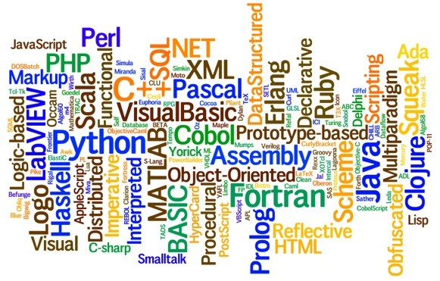
Programming languages

Slide 4
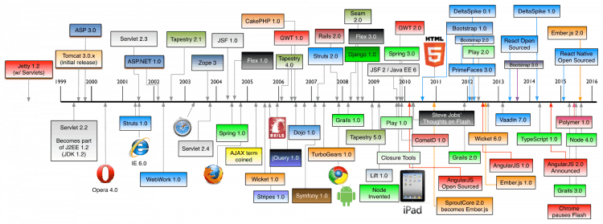
Programming languages

Slide 5
Why Python?
Python works on different platforms (Windows, Mac, Linux, Raspberry Pi, etc).
Python has a simple syntax similar to the English language.
Python has syntax that allows developers to write programs with fewer lines than some other programming languages.
Python runs on an interpreter system, meaning that code can be executed as soon as it is written. This means that prototyping can be very quick.
Python can be treated in a procedural way, an object-orientated way or a functional way.
Python relies on indentation, using whitespace, to define scope; such as the scope of loops, functions and classes. Other programming languages often use curly-brackets for this purpose.

Slide 6
History of python
Python was conceptualized by Guido Van Rossum in late 1980s.
Rossum published the fisrt version of python code (0.9.0) in Feb 1991 in Netherland.
Python is derive from ABC programming language, which is a general purpose programming language.
He has selected the name since he was a big fan of Monty Python’s Flying Circus.

Slide 7
What can Python do?
Python can be used on a server to create web applications.
Python can be used alongside software to create workflows.
Python can connect to database systems. It can also read and modify files.
Python can be used to handle big data and perform complex mathematics.
Python can be used for rapid prototyping, or for production-ready software development.

Slide 8
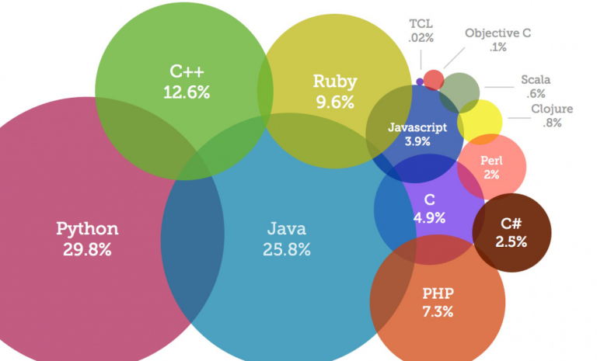
programming languages & Trends (2018)

Slide 9
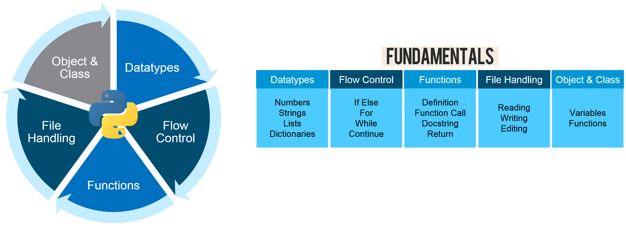
What comes under fundamentals?

Slide 10
Course outline
Language Fundamentals
Introduction
Definitions
Decision Controls
If else
conditions
Loops
For loop
While loop
Functions
Arrays
Body of functions
Writing of functions
1D and 2D arrays
Concepts
Pointers
Concepts of data accessing
Accessing data using pointers
Lists
Concepts
1D and 2D List
Dictionaries
Concept
Operations, Methods
File I/O
Types of filing
Concept

Slide 11
Python Advantages & Disadvantage
Simple and Easy
Extensible
Embeddable
Improved Productivity
IOT Opportunities
Extensive Libraries
Readable
Object Oriented
Free and Open Source
Portable
Speed Limitation
Design Restrictions
Simple
Underdeveloped Database Access Layers
Weak in Mobile Computing & Browsers

Slide 12
Python comparison to other languages
“Hello World Program in Python
Print (“Hello World !”)
“Hello World Program in C++
#include<iostream>
using namespace std;
int main()
{
print (“Hello World !”);
return 0;
}
“Hello World Program in Java
public class HelloWorld{
Public static void main (String[] args)
{
System.out.println(“Hello World !”);
}
}
“Hello World Program in C
#include<stdio.h>
int main()
{
print (“Hello World !”);
return 0;
}

Slide 13
Introduction to python programming
Some commonly acknowledged reasons
Short development time
Learning curve is not so steep as other languages
Anaconda is a big self contained Python distribution
Large library base
Runs on many platforms

Slide 14
Reserved words in python
and | assert | break | class | continue
def | del | elif | else | except
exec | finally | for | from | global
if | import | in | is | lambda
not | or | pass | print | raise
return | try | while

Slide 15

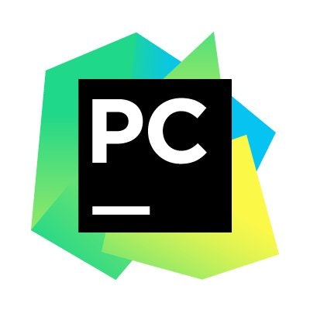
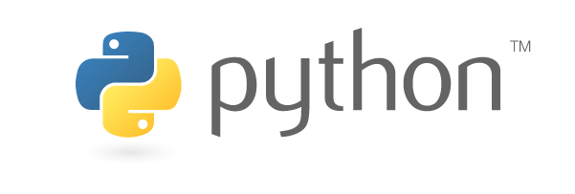
Python installation
Anaconda Continuum framework
Python interpreter
Pycharm IDE
https://www.anaconda.com/download/
https://www.python.org/downloads/

Slide 16
End of Lecture – Week 01

